Slide 1

Blockchains
& Distributed Ledgers
Lecture 04
Aggelos Kiayias
Slide credits: AK, Dimitris Karakostas, Aydin Abadi, Christos Nasikas, Dionysis Zindros

Slide 2


Smart Contracts
The developer writes and deploys the contract
B₁
B₂
B₃

Slide 3


Smart Contracts
The developer writes and deploys the contract
A user interacts with the contract via a transaction
B₁
B₂
B₃
…
B_{n}

Slide 4


Smart Contracts
The developer writes and deploys the contract
A user interacts with the contract
An adversary exploits a hazard in the contract, by sending a transaction that somehow breaks its functionality
B₁
B₂
B₃
…
B_{n}
…
B_{k}

Slide 5
Smart Contracts
The developer writes and deploys the contract
A user interacts with the contract
An adversary exploits a hazard in the contract, by sending a transaction that somehow breaks its functionality
In this lecture, you will learn:
How to identify hazards in contracts written by others
How to protect users (of your contracts) from known attacks

Slide 6
Denial-of-Service

Slide 7
DoS: Unbounded operation
for (uint i = 0; i < investors.length; i++) {
investors[i].addr.send(investors[i].dividendAmount));
}
https://cs.pomona.edu/~michael/courses/csci190s21/papers/madmax.pdf
Notes:
Accounts.length can be arbitrarily large - hence at some point there will be a DOS

Slide 8
DoS: Unbounded operation
// INSECURE
for (uint i = 0; i < investors.length; i++) {
investors[i].addr.send(investors[i].dividendAmount));
}
Operation requires more gas as array becomes larger
After some point, it might be impossible (beyond gas limits) to execute it
https://cs.pomona.edu/~michael/courses/csci190s21/papers/madmax.pdf
Notes:
investors.length can be arbitrarily large - hence at some point there will be a DOS

Slide 9
DoS: Griefing
for (uint i = 0; i < investors.length; i++) {
investors[i].addr.send(investors[i].dividendAmount));
}
https://cs.pomona.edu/~michael/courses/csci190s21/papers/madmax.pdf
Notes:
This contract sends dividends to all investors (as long as they hold some minimum investment) and resets their investment data.

Slide 10
DoS: Griefing
// INSECURE
for (uint i = 0; i < investors.length; i++) {
investors[i].addr.send(investors[i].dividendAmount));
}
https://cs.pomona.edu/~michael/courses/csci190s21/papers/madmax.pdf
Notes:
If send calls another contract which runs out-of-gas itself then the for loop it will get stuck (it will never complete for anyone). It is possible to make such run out of gas problem on purpose - hence “griefing.”
Investors[i].addr can be another smart contract and “send” can have the investors[i] receive function invoked.
Key-point is that errors need to be handled (as opposed to just revert).
Better use transfer which returns an error object that you can examine and decide accordingly what to do.

Slide 11
DoS: Griefing
// INSECURE
for (uint i = 0; i < investors.length; i++) {
investors[i].addr.send(investors[i].dividendAmount));
}
// ALSO INSECURE
for (uint i = 0; i < investors.length; i++) {
if (!(investors[i].addr.send(investors[i].dividendAmount))) {
revert(i);
}
}
https://cs.pomona.edu/~michael/courses/csci190s21/papers/madmax.pdf
Notes:
If send calls another contract which runs out-of-gas itself then the for loop it will get stuck (it will never complete for anyone). It is possible to make such run out of gas problem on purpose - hence “griefing.”
Key-point is that errors needs to be handled - see the second example.
A problem here is that simple revert will not be enough. why reverting is not enough? E.g., next time you call the contract it will be the same.
Better use transfer which returns an error object that you can examine and decide accordingly what to do.
add the example here
(bool sent, bytes memory data) = _to.call{value: msg.value}(""); require(sent, "Failed to send Ether");

Slide 12
Error handling
If a send/transfer call fails, the contract might get stuck
It is possible to force a call to fail (e.g., by getting the victim contract to send to another contract that fails)
Errors need to be handled, instead of simply reverting
transfer is preferable to send, as it returns an error object that can be examined to act accordingly

Slide 13
Pull over push: example
function bid() payable {
require(msg.value >= highestBid);
if (highestBidder != address(0)) {
highestBidder.transfer(highestBid);
}
highestBidder = msg.sender;
highestBid = msg.value;
}
https://consensys.github.io/smart-contract-best-practices
Notes:
This is a contract that receives a bid and refunds the previous highest bidder if he is outbid.
It uses the condition address(0) to test whether the highestbidder is indeed initialized.

Slide 14
Pull over push: example
// BAD DESIGN (PUSH)
function bid() payable {
require(msg.value >= highestBid);
if (highestBidder != address(0)) {
highestBidder.transfer(highestBid);
}
highestBidder = msg.sender;
highestBid = msg.value;
}
// GOOD DESIGN (PULL)
function bid() payable external {
require(msg.value >= highestBid);
if (highestBidder != address(0)) {
refunds[highestBidder] += highestBid;
}
highestBidder = msg.sender;
highestBid = msg.value;
}
function withdrawRefund() external {
uint refund = refunds[msg.sender];
refunds[msg.sender] = 0;
msg.sender.transfer(refund);
}
https://consensys.github.io/smart-contract-best-practices
Notes:
This is a contract that receives a bid and refunds the previous highest bidder if he is outbid.
It uses the condition equality test to address(0) to test whether the highestbidder is indeed initialized.

Slide 15
Pull over push
Do not transfer ETH to users (push); let them withdraw (pull) their funds.
Isolates each external call into its own transaction.
Avoids multiple send() calls in a single transaction.
Reduces problems with gas limits.
Possibly increases gas fairness (each user pays the gas for receiving their own funds).
Tradeoff between security and user experience.

Slide 16
Reentrancy

Slide 17
Reentrancy
Withdraw ETH
Contract A
Contract B
Notes:
Contract A withdraws some Ether from Contract B via its fallback function.

Slide 18
Reentrancy
Withdraw ETH
1. Call withdraw
Contract A
Contract B

Slide 19
Reentrancy
Fallback function
2. Give eth
Withdraw ETH
Contract A
Contract B

Slide 20
Reentrancy
Fallback function
Withdraw ETH
3. Call withdraw again
Contract A
Contract B

Slide 21
Reentrancy
Fallback function
Give eth
Withdraw ETH
Call withdraw again
Contract A
Contract B
Loop of function calls
Notes:
Loop of function calls which results in draining funds from Contract B and transferring to Contract A. the loop will stop at the discretion of contract A or when it runs out of gas.

Slide 22
Reentrancy example
// INSECURE
mapping (address => uint) private userBalances;
function withdrawBalance() public {
uint amountToWithdraw = userBalances[msg.sender];
require(msg.sender.call.value(amountToWithdraw)());
userBalances[msg.sender] = 0;
}
Notes:
Example smart contract that has an array of userBalances.
withdrawBalance() enables a user to withdraw her coins.
It uses require()on a msg.sender.call to succeed in order to move forward.

Slide 23
Reentrancy example
// INSECURE
mapping (address => uint) private userBalances;
function withdrawBalance() public {
uint amountToWithdraw = userBalances[msg.sender];
require(msg.sender.call.value(amountToWithdraw)());
userBalances[msg.sender] = 0;
}
Notes:
Key point – withdrawbalance calls the sender with the amounttowithdraw without zero-ing the balance first.

Slide 24
Reentrancy example
Begin attack by sending eth to attacker contract
// INSECURE
mapping (address => uint) private userBalances;
function withdrawBalance() public {
uint amountToWithdraw = userBalances[msg.sender];
require(msg.sender.call.value(amountToWithdraw)());
userBalances[msg.sender] = 0;
}
function receive() payable {
if (victimContract.balance >= msg.value) {
victim.withdrawBalance();
}
}
Notes:
victim is the contract to be attacked.
The above msg.sender.call.value call will result in calling the default function of the caller.
Note the attacker also wants to get out of the loop safely.
The attack will stop when the victimContract.balance is less than msg.value.
(the attacker chooses msg.value appropriately avoid a run out of gas exception which will revert the attack).

Slide 25
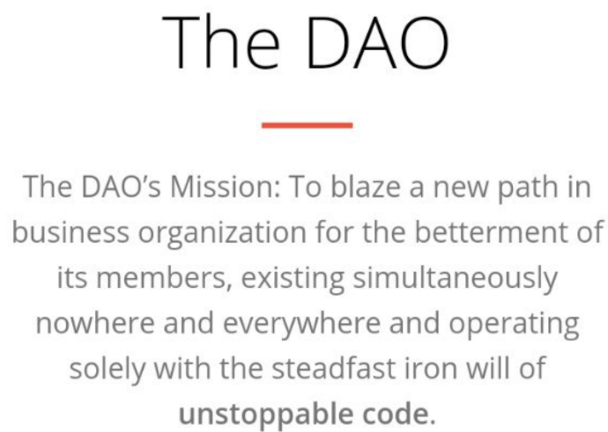
Re-entrancy in the wild: The DAO
The DAO (distributed autonomous organization*)
Designed by slock.it in 2016
Purpose: Create a population of stakeholders
Stake (in the form of DAO tokens) enables them to participate in decision making
Decision-making to choose which proposals to fund
*According to the SEC, neither “distributed” nor “autonomous”: https://www.sec.gov/news/press-release/2017-131

Slide 26
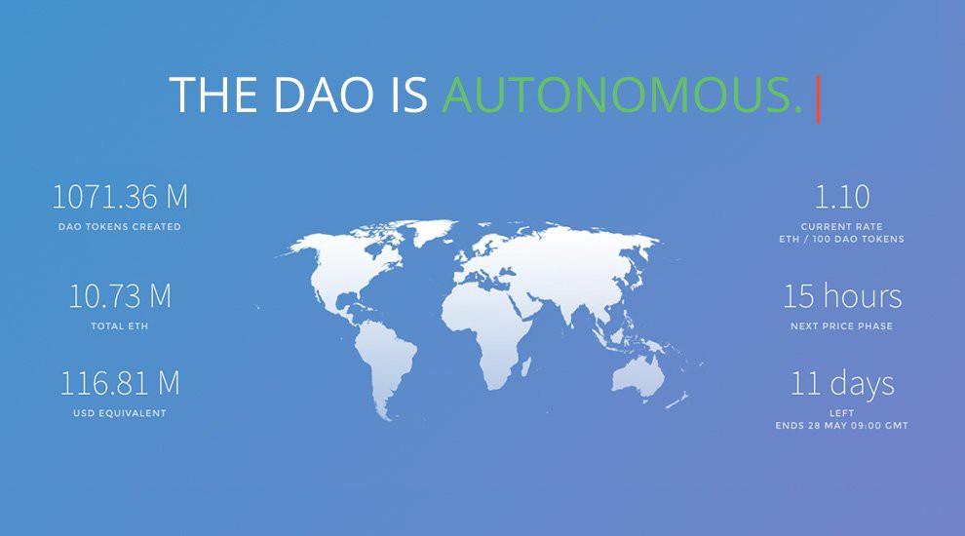
~150 million USD in ~ 1 month

Slide 27
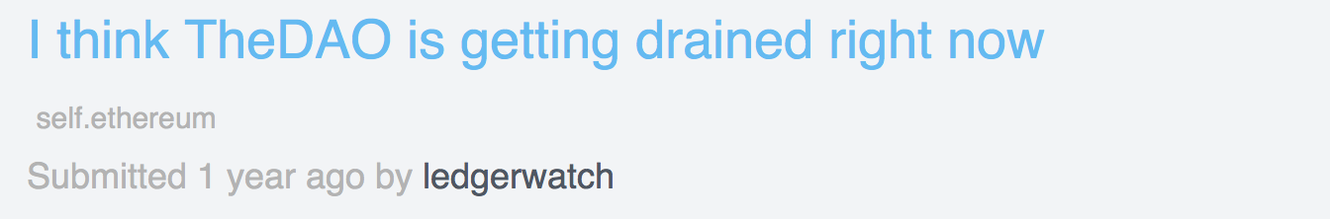
The DAO Attack (2016)
12 June: The reentrancy bug is identified (but stakeholders are “reassured”)
17 June: Attacker exploits it draining ~$50Million at the time of the attack
Active deliberation about changing the system to nullify the attack
15 July: Ethereum Classic manifesto
19 July: “Hard Fork” neutralizes attacker’s smart contract

Slide 28
Reentrancy: solutions
Finish all internal work (state changes) and then call external functions
Checks-Effects-Interactions Pattern
Mutexes
Pull-push pattern
Use transfer or send instead of call
// SECURE
mapping (address => uint) private userBalances;
function withdrawBalance() public {
uint amountToWithdraw = userBalances[msg.sender];
userBalances[msg.sender] = 0;
msg.transfer(amountToWithdraw);
}
Notes:
Transfer limits the amount of gas that will be available for each call of the fallback function of the receiving contract.
⇒ principle: First you check, then record the effects, then perform interactions
=> pull-push pattern: do local changes first; instead of pushing them, let the user of the contract pull them.

Slide 29
Checks-Effects-Interactions Pattern
Perform checks e.g., on inputs, sender, value, arguments etc
Enforce effects and update the state accordingly
Interact with other accounts via external calls or send/transfer

Slide 30
Solidity/Ethereum hazards

Slide 31
Forcibly Sending Ether to a Contract
Possible exploit
misuse of this.balance (when contract relies on it)
contract Vulnerable {
function receive() external {
revert();
}
function fallback() external {
revert();
}
function somethingBad() {
require(this.balance > 0);
// something bad
}
}
https://github.com/demining/Solidity-Forcibly-Send-Ether-Vulnerability
Notes:
Consider the above contract – it will reject any incoming payment.
Then presumably “somethingBad” never happens.
But this is not the case, it can be that an attacker makes balance>0

Slide 32
Forcibly Sending Ether to a Contract
Possible exploit
misuse of this.balance (when contract relies on it)
How can you send ether to a contract without firing contact’s fallback function ?
Notes:
imagine a contract that uses this.balance for some calculation. An attacker can set this.balance to an unpredictable value…

Slide 33
Forcibly Sending Ether to a Contract
Possible exploit
misuse of this.balance (when contract relies on it)
How can you send ether to a contract without firing contact’s fallback function ?
Contract’s address = hash(sender address, nonce): anyone can calculate a contract’s address before it is created and send ether to it
selfdestruct(victimContractAddress) does not trigger fallback/receive
Set contract’s address as recipient of block rewards
Notes:
imagine a contract that uses this.balance for some calculation. An attacker can set this.balance to an unpredictable value…
The first method is to call the selfdestruct method on a contract with the Vulnerable contract address set as the beneficiary. This works because selfdestruct will not trigger the fallback function.
Another method is to precompute a contract’s address and send Ether to the address before the contract is even deployed. Surprisingly enough, this is possible

Slide 34
Forcibly Sending Ether to a Contract
Possible exploit
misuse of this.balance (when contract relies on it)
How can you send ether to a contract without firing contact’s fallback function ?
Contract’s address = hash(sender address, nonce): anyone can calculate a contract’s address before it is created and send ether to it
selfdestruct(victimContractAddress) does not trigger fallback
Set contract’s address as recipient of block rewards
Lesson: Avoid strict equality checks with the contract’s balance
Notes:
imagine a contract that uses this.balance for some calculation. An attacker can set this.balance to an unpredictable value…

Slide 35
Delegate call
B
C
Storage
Storage

Slide 36
Delegate call
B
C
c.delegatecall(...)
Storage
Storage
Notes:
Contract B runs a function of contract C in its own context.
“c” is an instance of the contract C.

Slide 37
Delegate call
B
C
c.delegatecall(...)
Writes on B’s storage
Storage
Storage
Context (balance, msg, ...) is the same as B.
Only the code from C is loaded.
Notes:
Useful for a library call.

Slide 38

Delegate call
// INSECURE
address public owner;
Library library =
function() public {
require(library.delegatecall(msg.data));
}
address public owner;
constructor (address _owner) public {
owner = _owner;
}
function pwn() public {
owner = msg.sender;
}
}
Notes:
The attack contract changes the owner! To the transaction caller of the left contract.

Slide 39
Use of tx.origin
A
tx.origin = A
msg.sender = A
B
tx.origin = A
msg.sender = B
C
Personal account
Contract
Contract

Slide 40
Use of tx.origin
// INSECURE
contract Bank {
address owner;
constructor() public {
owner = msg.sender;
}
function sendTo(address payable receiver, uint amount) public {
require(tx.origin == owner);
receiver.call.value(amount)();
}
}
Notes:
Constructor = Bank
The bank sends money

Slide 41
Use of tx.origin
// INSECURE
contract Bank {
address owner;
constructor() public {
owner = msg.sender;
}
function sendTo(address payable receiver, uint amount) public {
require(tx.origin == owner);
receiver.call.value(amount)();
}
}
function receive() external payable {
victim.sendTo(attacker,msg.sender.balance);
}
Notes:
The bank owner sends some money to the attacker contract (for whatever reason). The resulting call function results in the fallback function of the attacker’s contract being executed. This calls sendTo again (recall it is a public function). The tx.origin corresponding to the second call is correct but corresponds only to the first call to sendTo which was the legitimate one.

Slide 42
Keep fallback function simple
// BAD
function receive() payable {
balances[msg.sender] += msg.value;
}
// GOOD
function deposit() payable external {
balances[msg.sender] += msg.value;
}
function receive() payable {
require(msg.data.length == 0);
emit LogDepositReceived(msg.sender);
}
https://consensys.github.io/smart-contract-best-practices
Notes:
Emit an event that you have received some funds. Note that msg.data.length <> 0 does not correspond to receiving funds. Fallback function will be also activated when a non-existent function is called.

Slide 43
Default values
And
Merkle Trees

Slide 44
Sparse Merkle Trees
Perfect Binary Merkle Tree
Unfilled leaves take default values

Slide 45
Sparse Merkle Trees
H_{root}= H( H_{1,4} || H_{5,8} )
H_{1,4} = H( H_{1,2} || H∅,∅ )
H_{5,8}
H_{1,2} = H( H₁ || H₂ )
H∅,∅ = H( H∅ || H∅ )
H₁= H(D₁)
H₂= H(D₂)
H∅= H(∅)
H∅= H(∅)
H∅= H(∅)
H₆= H(D₆)
H∅= H(∅)
H₈= H(D₈)
H
H
H
H
H
H
H
H
D₁
D₂
∅
∅
∅
D₆
∅
D₈

Slide 46
Sparse Merkle Trees: key-value stores
Assume that keys are 256 bits (e.g., a SHA256 hash)
Construct a Sparse Merkle Tree with 2²⁵⁶ leaves
Insert a (key, value) element in the store
Insert the value in the leaf that corresponds to the key
Construct the root of the new Merkle Tree
Proof of inclusion: as usual
Proof of non-inclusion: prove empty value in leaf for corresponding key
Constructing such tree for 2²⁵⁶ leaves from scratch is extremely consuming
Optimizations?

Slide 47
Solidity’s default values
Solidity does not support None/null types
Every variable is initialized to a (respective) zero value
uint256: 0
bytes32: bytes32(0)
…
Verifying whether a string is not initialized:
bytes(myVariable).length != 0
sha3(myVariable) != sha3("")

Slide 48
The Nomad Bridge Hack
Nomad contract kept:
mapping of MTRs to timestamps: mapping(bytes32 => uint256) confirmAt
Intended use: Timestamp after which an MTR can be used for message validation
function acceptableRoot(bytes32 _root) public view returns (bool) {
// ...
uint256 _time = confirmAt[_root];
if (_time == 0) {
return false;
}
return block.timestamp >= _time;
}
https://medium.com/nomad-xyz-blog/nomad-bridge-hack-root-cause-analysis-875ad2e5aacd

Slide 49
The Nomad Bridge Hack
Nomad contract kept:
mapping of MTRs to timestamps: mapping(bytes32 => uint256) confirmAt
Intended use: Timestamp after which an MTR can be used for message validation
mapping of message hashes to MTRs: mapping(bytes32 => bytes32) messages
Intended use: if a message is validated, the mapping keeps the message’s hash and the MTR used to validate it => the mapping is implemented by a Sparse MT
function process(bytes memory _message) public returns (bool _success) {
// ...
require(acceptableRoot(messages[_messageHash]), "!proven");
// ...
}
https://medium.com/nomad-xyz-blog/nomad-bridge-hack-root-cause-analysis-875ad2e5aacd
Notes:
Messages logic: the MT proof is checkedand then added.

Slide 50
The Nomad Bridge Hack
Nomad contract kept:
mapping of MTRs to timestamps: mapping(bytes32 => uint256) confirmAt
Intended use: Timestamp after which an MTR can be used for message validation
mapping of message hashes to MTRs: mapping(bytes32 => bytes32) messages
Intended use: if a message is validated, the mapping keeps the message’s hash and the MTR used to validate it
On 21 June 2022, a new version of the contract was created
During initialization, Nomad set: confirmAt[bytes32(0)] = 1
Attack!
https://medium.com/nomad-xyz-blog/nomad-bridge-hack-root-cause-analysis-875ad2e5aacd

Slide 51
The Nomad Bridge Hack
Nomad contract kept:
mapping of MTRs to timestamps: mapping(bytes32 => uint256) confirmAt
mapping of message hashes to MTRs: mapping(bytes32 => bytes32) messages
On 21 June 2022, a new version of the contract was created
During initialization, Nomad set: confirmAt[bytes32(0)] = 1
Attack!
Every non-validated message is initialized to the zero MTR in the messages mapping
https://medium.com/nomad-xyz-blog/nomad-bridge-hack-root-cause-analysis-875ad2e5aacd

Slide 52
The Nomad Bridge Hack
Nomad contract kept:
mapping of MTRs to timestamps: mapping(bytes32 => uint256) confirmAt
mapping of message hashes to MTRs: mapping(bytes32 => bytes32) messages
On 21 June 2022, a new version of the contract was created
During initialization, Nomad set: confirmAt[bytes32(0)] = 1
Attack!
Every non-validated message is initialized to the zero MTR in the messages mapping
By setting confirmAt[bytes32(0)] = 1, the zero MTR gets “confirmed” at timestamp 1
https://medium.com/nomad-xyz-blog/nomad-bridge-hack-root-cause-analysis-875ad2e5aacd

Slide 53
The Nomad Bridge Hack
Nomad contract kept:
mapping of MTRs to timestamps: mapping(bytes32 => uint256) confirmAt
mapping of message hashes to MTRs: mapping(bytes32 => bytes32) messages
On 21 June 2022, a new version of the contract was created
During initialization, Nomad set: confirmAt[bytes32(0)] = 1
Attack!
Every non-validated message is initialized to the zero MTR in the messages mapping
By setting confirmAt[bytes32(0)] = 1, the zero MTR gets “confirmed” at timestamp 1
So, every previously non-validated message now becomes validated
https://medium.com/nomad-xyz-blog/nomad-bridge-hack-root-cause-analysis-875ad2e5aacd

Slide 54
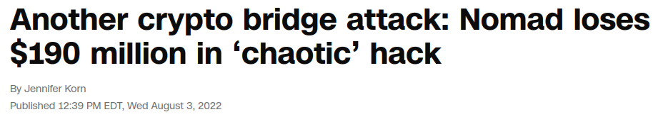
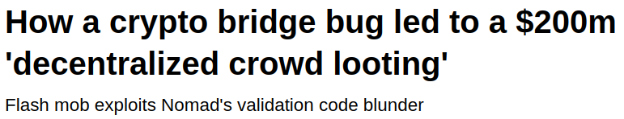
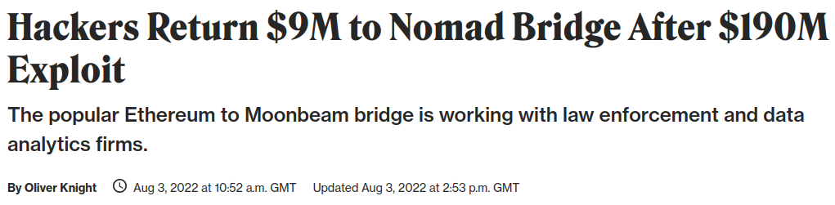
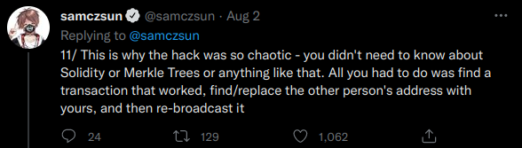
The Nomad Bridge Hack

Slide 55
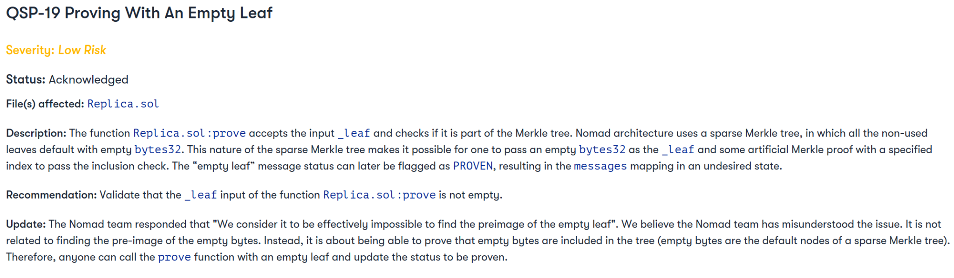
The Nomad Bridge Hack
https://github.com/nomad-xyz/docs/blob/1ff0c55dba2a842c811468c57793ff9a6542ef0f/docs/public/Nomad-Audit.pdf

Slide 56
The Nomad Bridge Hack - Lessons
Always check user input thoroughly
Especially for empty values
Every object has a value
Even if never accessed before, it has a zero value
When an auditor flags a bug, fix it

Slide 57
Binance Bridge Hack
Binance Bridge used a sophisticated implementation of AVL Merkle Trees
AVL trees: self-balancing binary search trees
In this implementation, verification contains special operations that need to succeed
Root hash is computed in a pretty complex manner (source code)
Attacker
Changed a leaf’s value, inserting the malicious payload
Added an inner node in a way that verification for original MTR passed
https://twitter.com/samczsun/status/1578167198203289600

Slide 58
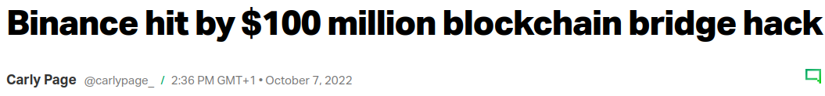
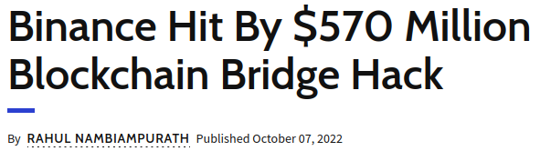
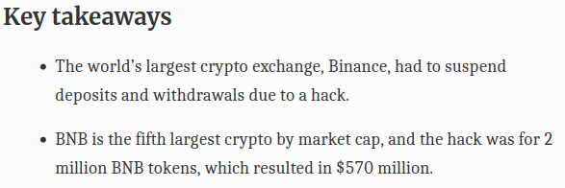
Binance Bridge Hack

Slide 59
Binance Bridge Hack
Binance Bridge used a sophisticated implementation of AVL Merkle Trees
AVL trees: self-balancing binary search trees
In this implementation, verification contains special operations that need to succeed
Root hash is computed in a pretty complex manner (source code)
Attacker
Changed a leaf’s value, inserting the malicious payload
Added an inner node in a way that verification for original MTR passed
Lessons:
Keep it simple
Don’t roll your own crypto
https://twitter.com/samczsun/status/1578167198203289600

Slide 60
Front-running

Slide 61
Front-Running
tx
tx
tx
tx
tx
tx
tx
tx
tx
tx
tx
tx
Miner: sortByGasPrice(txs, ‘desc’)
Notes:
Miner sorts transactions by gas-price.

Slide 62
Front-Running: user
50 GWei
tx
2 GWei
tx

Slide 63
Front-Running: user
tx
tx
tx
tx
tx
tx
tx
tx
tx
tx
tx
tx

Slide 64
Front-Running: miner
1 GWei
tx
2 GWei
tx

Slide 65
Front-Running: miner
1 GWei
tx
tx
tx
tx
tx
tx
tx
tx
tx
2 GWei
tx
tx
tx
tx
tx

Slide 66
Front-Running: example
// INSECURE
function registerName(bytes32 name) public {
names[name] = msg.sender;
}
Notes:
This is clearly bad.. Front-running enables an attack to register the name first.

Slide 67
Front-Running: solution
Employ a cryptographic commitment scheme
Implementation
commit: c = hash(<value, nonce>) (Note: nonce space should be large!)
reveal: v = <value’, nonce’>
verify: c == hash(v)
Properties
Binding: a commitment can be opened only to its committed value
Hiding: a commitment reveals no information about its committed value

Slide 68
Front-Running: solution example
// INSECURE
function registerName(bytes32 name) public {
names[name] = msg.sender;
}
// MORE SECURE, BUT…
function registerName(bytes32 name, bytes32 nonce) public {
require(commitments[makeCommitment(name, nonce)] == msg.sender, “Not found!”);
names[name] = msg.sender;
}
Notes:
A way to solve this is to use a non-interactive cryptographic commitment. registerName will work only after the user has committed to the name.

Slide 69
Front-Running: example
2 GWei
tx
Network
contract.commit(“9505cacb”)

Slide 70
Front-Running: example
Network
2 GWei
tx
contract.commit(“9505cacb”)

Slide 71
Front-Running: example
2 GWei
tx
Network
contract.registerName(“super”, “12345”)

Slide 72
Front-Running: example
2 GWei
tx
Network
contract.registerName(“super”, “12345”)
50 GWei
tx
contract.registerName(“super”, “12345”)

Slide 73
Front-Running: another solution
Employ a cryptographic commitment scheme
Keep track of committed values
Prevent a user from posting a commitment already posted by another user
Possible DoS and forced gas cost
Attacker can front-run a user’s commit operation and post the commitment as their own
User is forced to spend extra gas for new tx that posts new commitment
Attacker can continue front-running until they run out of money (to pay gas)

Slide 74
Randomness

Slide 75
Randomness: sources (?)
block.number
block.timestamp
block.hash
block.difficulty
block.coinbase
block.gasLimit
now
msg.sender
uint(keccak256(
timestamp
msg.sender
hash
...
)) % n
Notes:
block.& refers to the block where the transaction belongs to.
now = block.timestamp

Slide 76

Randomness: sources (?)
block.number
block.timestamp
block.hash
block.difficulty
block.coinbase
block.gasLimit
now
msg.sender
They can be manipulated by a malicious miner.
They are shared within the same block to all users.

Slide 77
Randomness
// INSECURE
bool won = (block.number % 2) == 0;
// INSECURE
uint random = uint(keccak256(block.timestamp)) % 2;
// INSECURE
address seed1 = contestants[uint(block.coinbase) % totalTickets].addr;
address seed2 = contestants[uint(msg.sender) % totalTickets].addr;
uint seed3 = block.difficulty;
bytes32 randHash = keccak256(seed1, seed2, seed3);
uint winningNumber = uint(randHash) % totalTickets;
address winningAddress = contestants[winningNumber].addr;

Slide 78
Randomness: blockhash
Not really private
Also not private
// INSECURE
uint256 private _seed;
function random(uint64 upper) public returns (uint64 randomNumber) {
_seed = uint64(keccack256(keccack256(block.blockhash(block.number), _seed), now));
return _seed % upper;
}
Notes:
_seed can be seen by anyone.

Slide 79
Randomness: blockhash
Not really private
// INSECURE
uint256 constant private FACTOR = 1157920892373161954235709850086879078532699846656405640394575840079131296399;
function rand(uint max) constant private returns (uint256 result) {
uint256 factor = FACTOR * 100 / max;
uint256 lastBlockNumber = block.number - 1;
uint256 hashVal = uint256(block.blockhash(lastBlockNumber));
return uint256((uint256(hashVal) / factor)) % max;
}

Slide 80
Randomness: intra-transaction information leak
if (replicatedVictimConditionOutcome() == favorable)
victim.tryMyLuck();
https://media.dedaub.com/bad-randomness-is-even-dicier-than-you-think-7fa2c6e0c2cd
Notes:
Transactions in the same block, may be using the same variables for randomness. An attacker contract as shown above can check whether the conditions are favorable and only then try its luck by running the suitable method in the victim contract. In this way, the attacker will invoke the victim method only when it wins.

Slide 81
Sources of randomness
Block information can be manipulated by miner
Block information shared by all users in the same block
In Ethereum, all data posted on the chain are visible
“private” vars are only private w.r.t. object-oriented programming visibility
If same-block txs share randomness source, attacker can check whether conditions are favorable before acting

Slide 82
What about future blocks ?
Notes:
if the second step of the above protocol is performed too late (>256 blocks later) or too early (in the same transaction as the first step), the result (zero) of blockhash will be known to an attacker
Validate block.number age!
A miner can mine blocks and hide them until he mines a favorable one (say about incentives of doing)

Slide 83
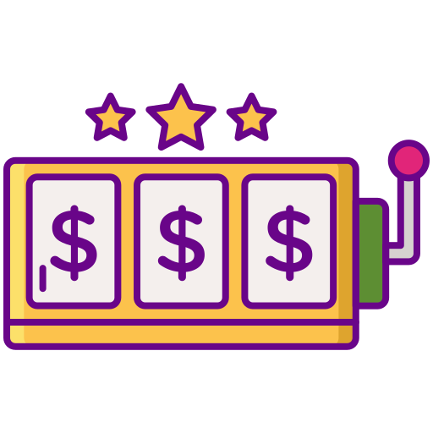

Casino
Player

Slide 84
1. Player makes a bet and the casino stores the block.number of the transaction
Casino
Player

Slide 85
2. A few blocks later, player requests from the casino to announce the winning number
Casino
Player

Slide 86
3. Casino uses, as a source of randomness, the hash of a block produced after the bet is placed
Casino
Player
Notes:
There is still a problem that you can get only the hash of the last 256 blocks (the blockhash will be zero otherwise). Validate block.number age!

Slide 87
Validate block.number age!
3. Casino uses, as a source of randomness, the hash of a block produced after the bet is placed
Casino
Player
Notes:
Said it is ok but there is a problem that you can get the hash of the last 256 blocks (the blockhash will be zero). Validate block.number age!

Slide 88
Is the hash of a future block a good source of randomness (against a malicious miner)?
A contract can access the hashes of only the last 256 blocks; blockhash older than that defaults to 0
Always validate block’s age
With some probability (how high?), a malicious miner will create the specific future block
In PoS, the proposer of a future block might be known beforehand
A miner can keep newly-mined blocks hidden, until they mine a favorable one

Slide 89
Randomness: towards safer PRNG
Commitment schemes
Prover commits to a message m by publishing h = H(m) (H is a hash function)
After some time, prover reveals message m
Verifier wants to be sure that the originally committed message is the revealed one
Verifier checks that: h == H(m)
Binding property:
Collision resistance: it should be infeasible to find m’ s.t. H(m) == H(m’)
Hiding property:
Honest prover wants no information about m to be retrievable from H(m)
H needs to behave as a random oracle
m should be unpredictable; if domain is small, use salt

Slide 90
Randomness: towards safer PRNG
Commitment schemes
Example:
Casino and player each commit to a random value
Casino and player reveal their values
Casino XORs the random values to produce a seed
the seed can also be combined with the hash of a future block
If either casino or player honest, then the seed is random (why?)
What happens in the case of aborts?

Slide 91
On-chain data is public
Applications (games, auctions, etc) required data to be private up until some point in time
Every data that is published on-chain is visible by everyone
Best strategy: commitment schemes
Watch out for front-running!

Slide 92
Overflow/Underflow

Slide 93


2 ²⁵⁶ - 1
0
2 ²⁵⁴
2 ²⁵⁵

Slide 94
Integer Overflow and Underflow
// INSECURE
function withdraw(uint256 _value) {
require(balanceOf[msg.sender] >= _value);
msg.sender.call.value(_value)();
balanceOf[msg.sender] -= _value;
}

Slide 95
Integer Overflow and Underflow
// INSECURE
function withdraw(uint256 _value) {
require(balanceOf[msg.sender] >= _value);
msg.sender.call.value(_value)();
balanceOf[msg.sender] -= _value;
}
Notes:
msg.sender.call.value = calls the anonymous fallback function on msg.sender
“msg.sender” represents the address of the account that called the function present within the smart contract. What if one smart contract calls another smart contract? In this case, the “msg.sender” will have the address of the calling smart contract instead of an account address.

Slide 96
Integer Overflow and Underflow
function attack() {
performAttack = true;
victim.donate(1);
victim.withdraw(1);
}
// INSECURE
function withdraw(uint256 _value) {
require(balanceOf[msg.sender] >= _value);
msg.sender.call.value(_value)();
balanceOf[msg.sender] -= _value;
}
function donate(uint256 _value) public payable {
require(msg.value == value);
balanceOf[msg.sender] += _value;
}
function() {
if (performAttack) {
performAttack = false;
victim.withdraw(1);
}
}
Notes:
Decrement by 1 will run twice in the balanceof[] array resulting by underflow to a 2^(256)-1 balance.
Using reentrancy.

Slide 97
Integer Overflow and Underflow: solutions
// OpenZeppelin: SafeMath.sol
function add(uint256 a, uint256 b) internal pure returns (uint256) {
uint256 c = a + b;
require(c >= a, "SafeMath: addition overflow");
return c;
}
function sub(uint256 a, uint256 b) internal pure returns (uint256) {
require(b <= a, "SafeMath: subtraction overflow");
uint256 c = a - b;
return c;
}
Solidity 0.8+ protects natively against over/underflows.
For older versions, use OpenZeppelin’s SafeMath library.
Notes:
You can use delegatecall to use these functions in the context of your contract (assuming they are deployed in a contract in the blockchain).

Slide 98
(Gas) Fairness

Slide 99

Gas Fairness
Crowdfunding Contract #1
R sets a threshold
Contract collects contributions
When balance exceeds threshold, it sends funds to R and returns any surplus to contributors.
Funding paid by last contributor

Slide 100
Gas Fairness
Crowdfunding Contract #1
R sets a threshold
Contract collects contributions
When balance exceeds threshold, it sends funds to R and returns any surplus to contributors.
Crowdfunding Contract #2
R sets a threshold
Contract collects contributions
When balance exceeds threshold, it allows R to withdraw the threshold and return any surplus to contributors
vs.
Funding paid by last contributor
R pays for funding

Slide 101
Gas Fairness
Crowdfunding Contract #1
R sets a threshold
Contract collects contributions
When balance exceeds threshold, it sends funds to R and returns any surplus to contributors.
Crowdfunding Contract #2
R sets a threshold
Contract collects contributions
When balance exceeds threshold, it allows R to withdraw the threshold and return any surplus to contributors
Crowdfunding Contract #3
R sets a threshold
Contract collects contributions
When balance exceeds threshold, it allows R and contributors to withdraw the threshold and surplus respectively
vs.
vs.
Funding paid by last contributor
R pays for funding
R and contributors pay for funding

Slide 102
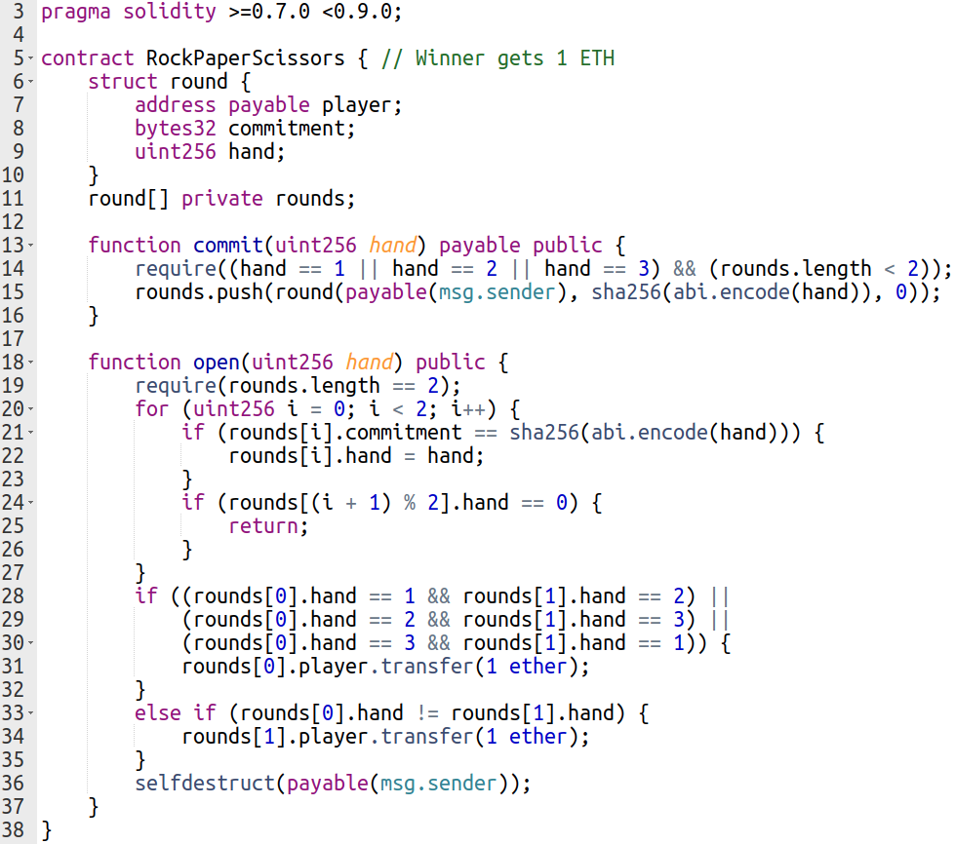
A (horribly insecure) ✊✋✌️ contract
Notes:
Plaintext argument
No salt
No predefined deposit
DoS on transfer
DoS on invalid commitment
Unfair gas

